Slide 1
CSE3150 Front-end Full Stack Development
Mini Project
TITLE-CHAT APP
The team:-
Roll no:20201CSE0665 Name: KAKARLA MEHRUNNISA
Roll no:20201CSE0675 Name: LATTHIKA
Roll no:20201CSE0667 Name SONA
Roll no:20201CSE0685 Name: PALLAVI

Slide 2
Abstract
This breaks down everything you need to know to create a React Chat App.
With online statuses
great design and functionality
icons telling you who read the message
image support
sound notifications
the ability to create multiple rooms and much more,

Slide 3
Design components in the front end
we start off with a login screen where you can enter your username and password you have to use the credentials that were given to you by the chat admin once you log in you'll be greeted with this great looking chat application
In the left side you can see all the chat rooms that the currently logged in
Immediately on the right side you have a list of all the people available in the chat room
If we logged in as the admin it even allows us to add new people into the chat app
There's even a sound notification that notifies you when there's a new message
You can get a person ,you can edit the person or delete them and you can also create new people that are going to join your chat all using the server rest api.

Slide 4
Tools used
All of the great features of this application are made possible by chat engine chat
Engine uses sockets behind the scenes and it allows you to create a simple chat
We are using visual studio code for coding
Netlify to deploy Chat app

Slide 5
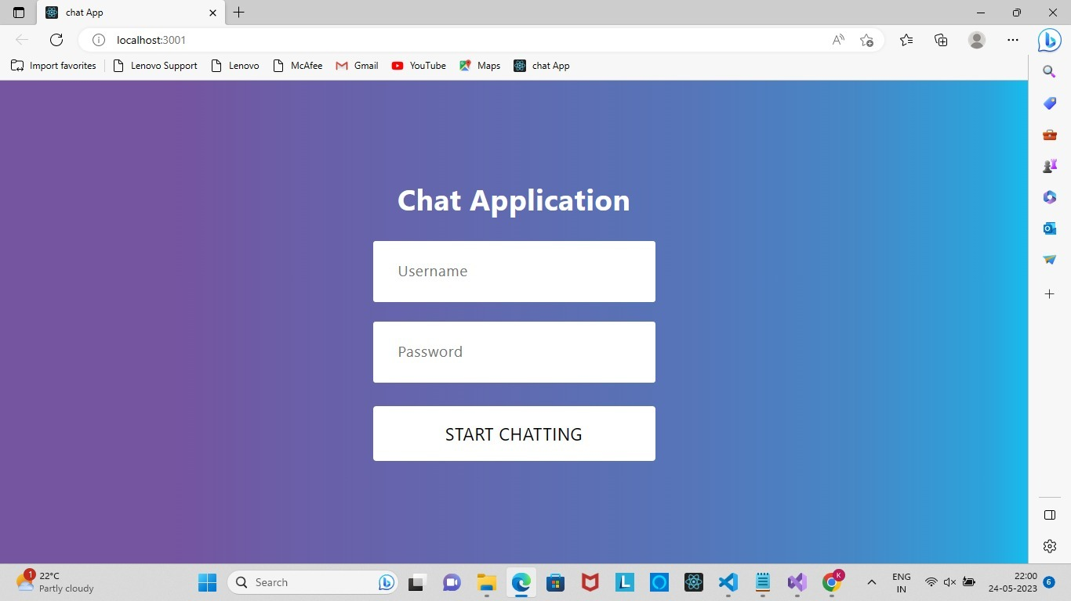
Outcome

Slide 6
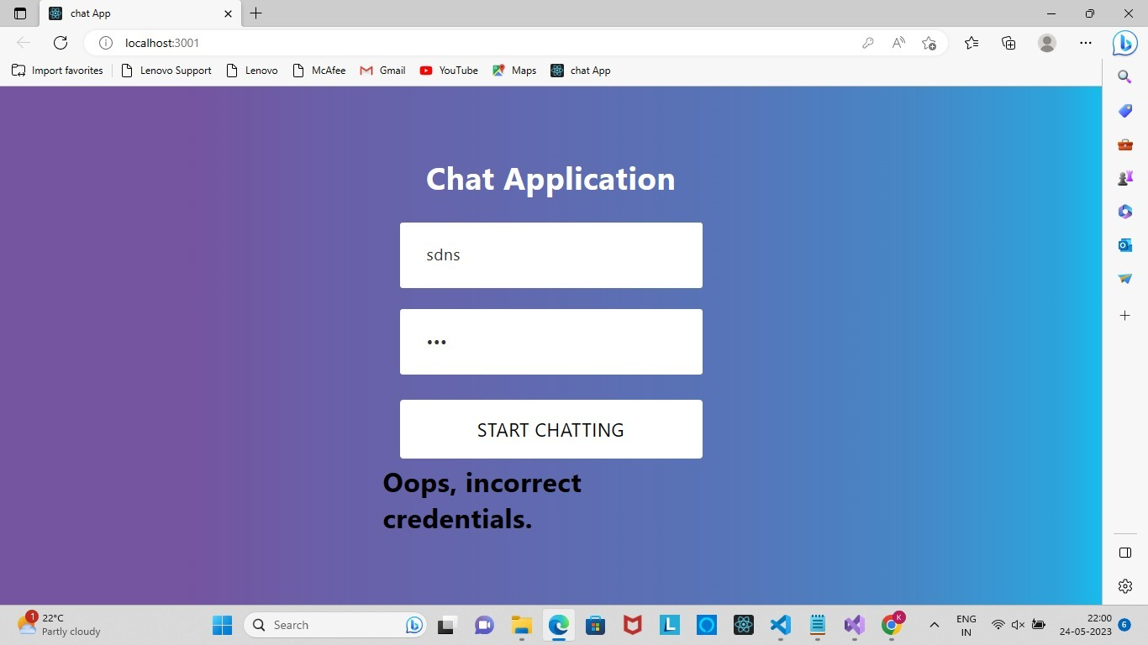
Outcome

Slide 7
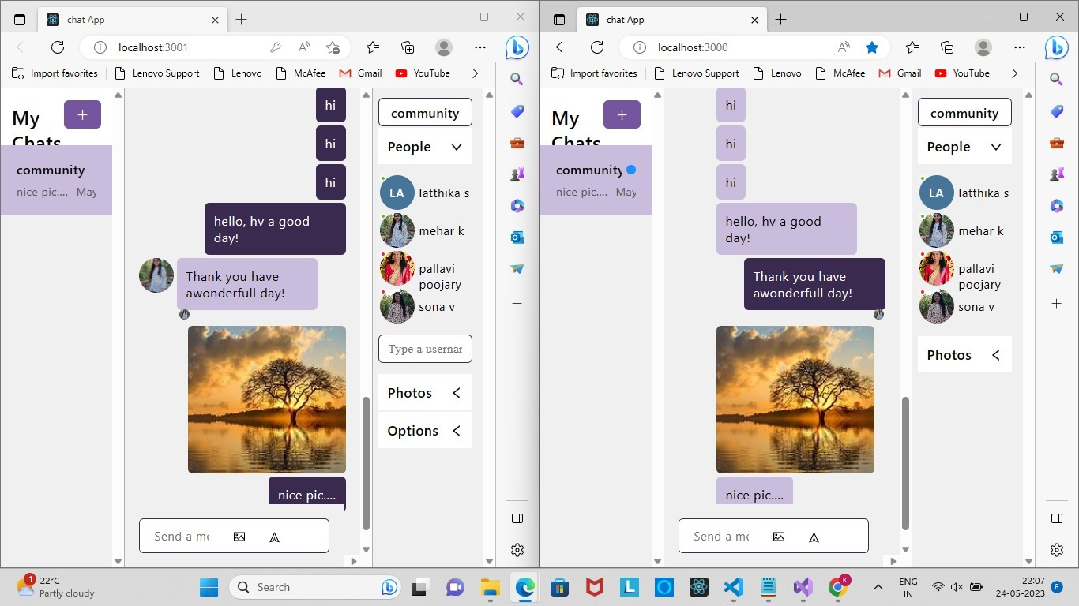
Outcome

Slide 8
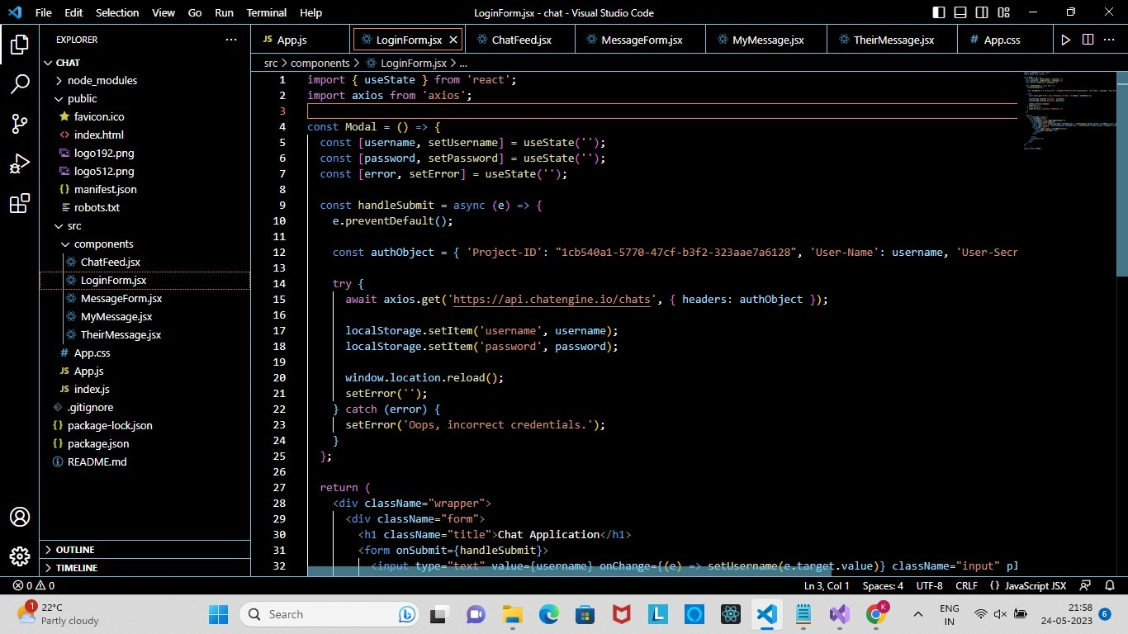
Code
3 Screen shots of core code

Slide 9
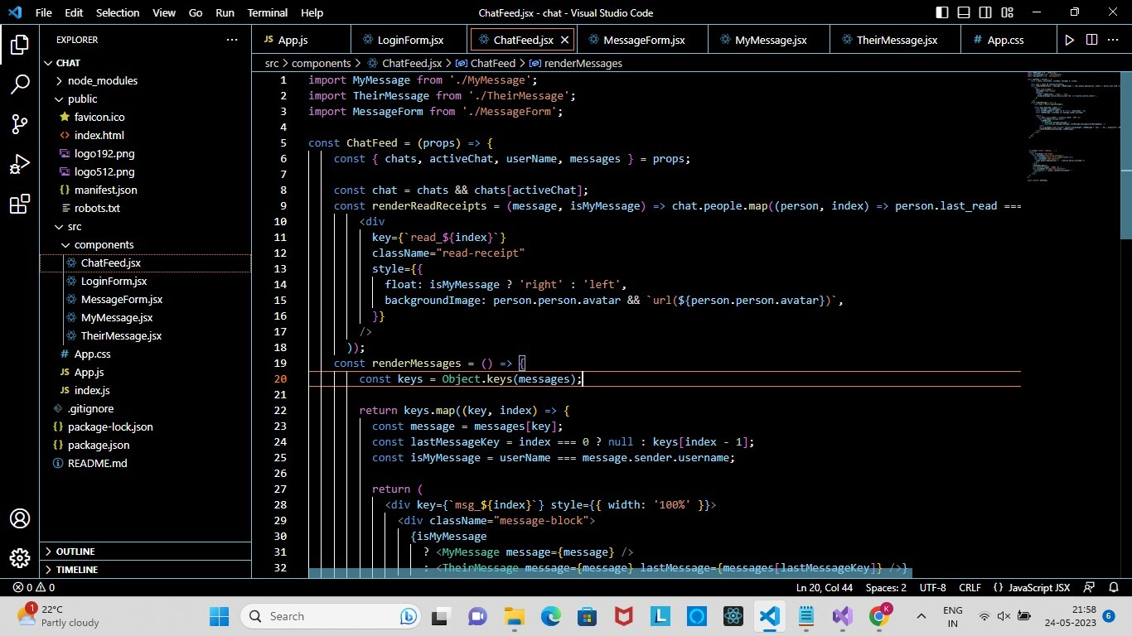
Code

Slide 10
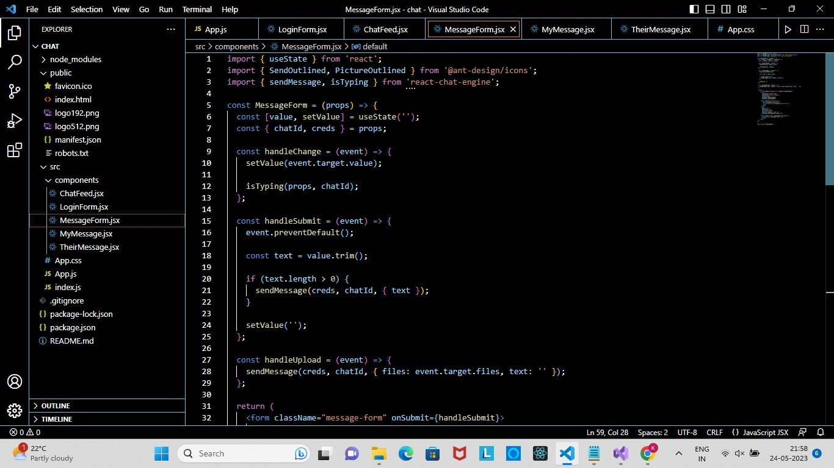
Code

Slide 11
Drawbacks of your project
What is not done ->
Video call option
voice call
What may improve it ->
adding the above mentioned features can improve the efficiency of app

Slide 12
Future work
sound notifications
share file
voice msg
Video call

Slide 13
What you learned new
Sockets
Rest APIs
Sending Images
React Hooks
Props and CSS
JavaScript

Slide 14
Conclusion
An Chat App
Where we can add any number of people we need
We can add,edit and remove the number of people in the app
Can share images
Create multiple rooms to chat privately or with only certained number of people
Sound notification

